Slide 1
29 – Clean Code – Design Patterns –Builder and Visitor Patterns
Based on the CleanCoders videos by Uncle Bob Martin
Rupert Waldron

Slide 2
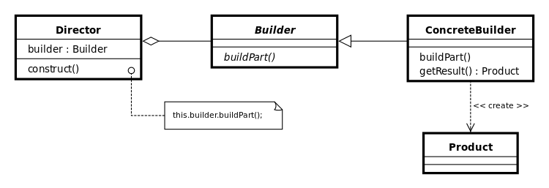
The Builder Pattern
The builder pattern separates the construction of a complex object from its representation so that the same construction process can create different representations

Slide 3
Basic builder pattern
public class Monkey { private String name; private int age; private Food food; // private constructor private Monkey() {} public static MonkeyBuilder builder() { return new MonkeyBuilder(); } @Override public String toString() { return "Monkey{" + "name='" + name + '\'' + ", age=" + age + ", food=" + food + '}'; } public static class MonkeyBuilder {}
public enum Food { BANANNA, APPLE } public static void main(String[] args) { Monkey monkey = Monkey.builder() .age(2) .name("Coco") .food(Food.APPLE) .build(); System.out.println("Monkey -> " + monkey); } }
public static class MonkeyBuilder { private String name; private int age; private Food food; public MonkeyBuilder name(String name) { this.name = name; return this; } public MonkeyBuilder age(int age) { this.age = age; return this; } public MonkeyBuilder food(Food food) { this.food = food; return this; } public Monkey build() { Monkey monkey = new Monkey(); monkey.name = this.name; monkey.age = this.age; monkey.food = this.food; return monkey; } }

Slide 4
Functional Builder
public class TestBuilder { public static void main(String[] args) { Customer bob = Customer.builderOf("bob", "smith") .withAddress("7 Beachamp Road") .withAge(68) .withPhoneNumber("7049653") .withSex(Customer.Sex.MALE) .build(); System.out.println(bob); Patient sam = Patient.builderOf("Sam", "Waldron") .with(builder -> { builder.age = 33; builder.address = ”59 Barns Lane"; builder.phoneNumber = "0118996722"; builder.sex = Patient.Sex.FEMALE; }).build(); System.out.println(sam); } }
Traditional Approach
Using Java8 Consumers

Slide 5
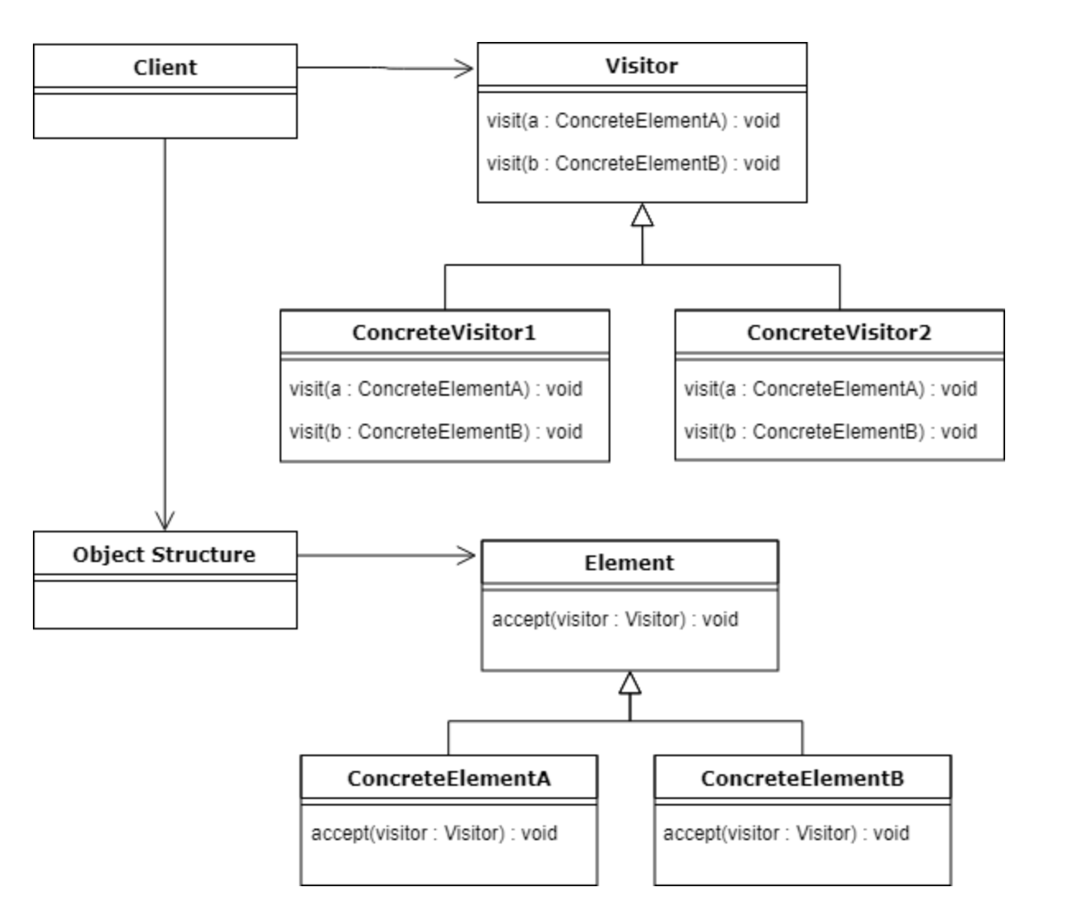
Visitor Pattern
Use the visitor pattern when you want to add behaviour to a class but don’t want that class to contain the behaviour.
Adding the functionality provided to the class would break the Single Responsibility Principle – the objects don’t care about the new functionality which is required by another Actor.
It also violates the Open Close Principle because each time new functionality is required it would have to be added to the class.

Slide 6
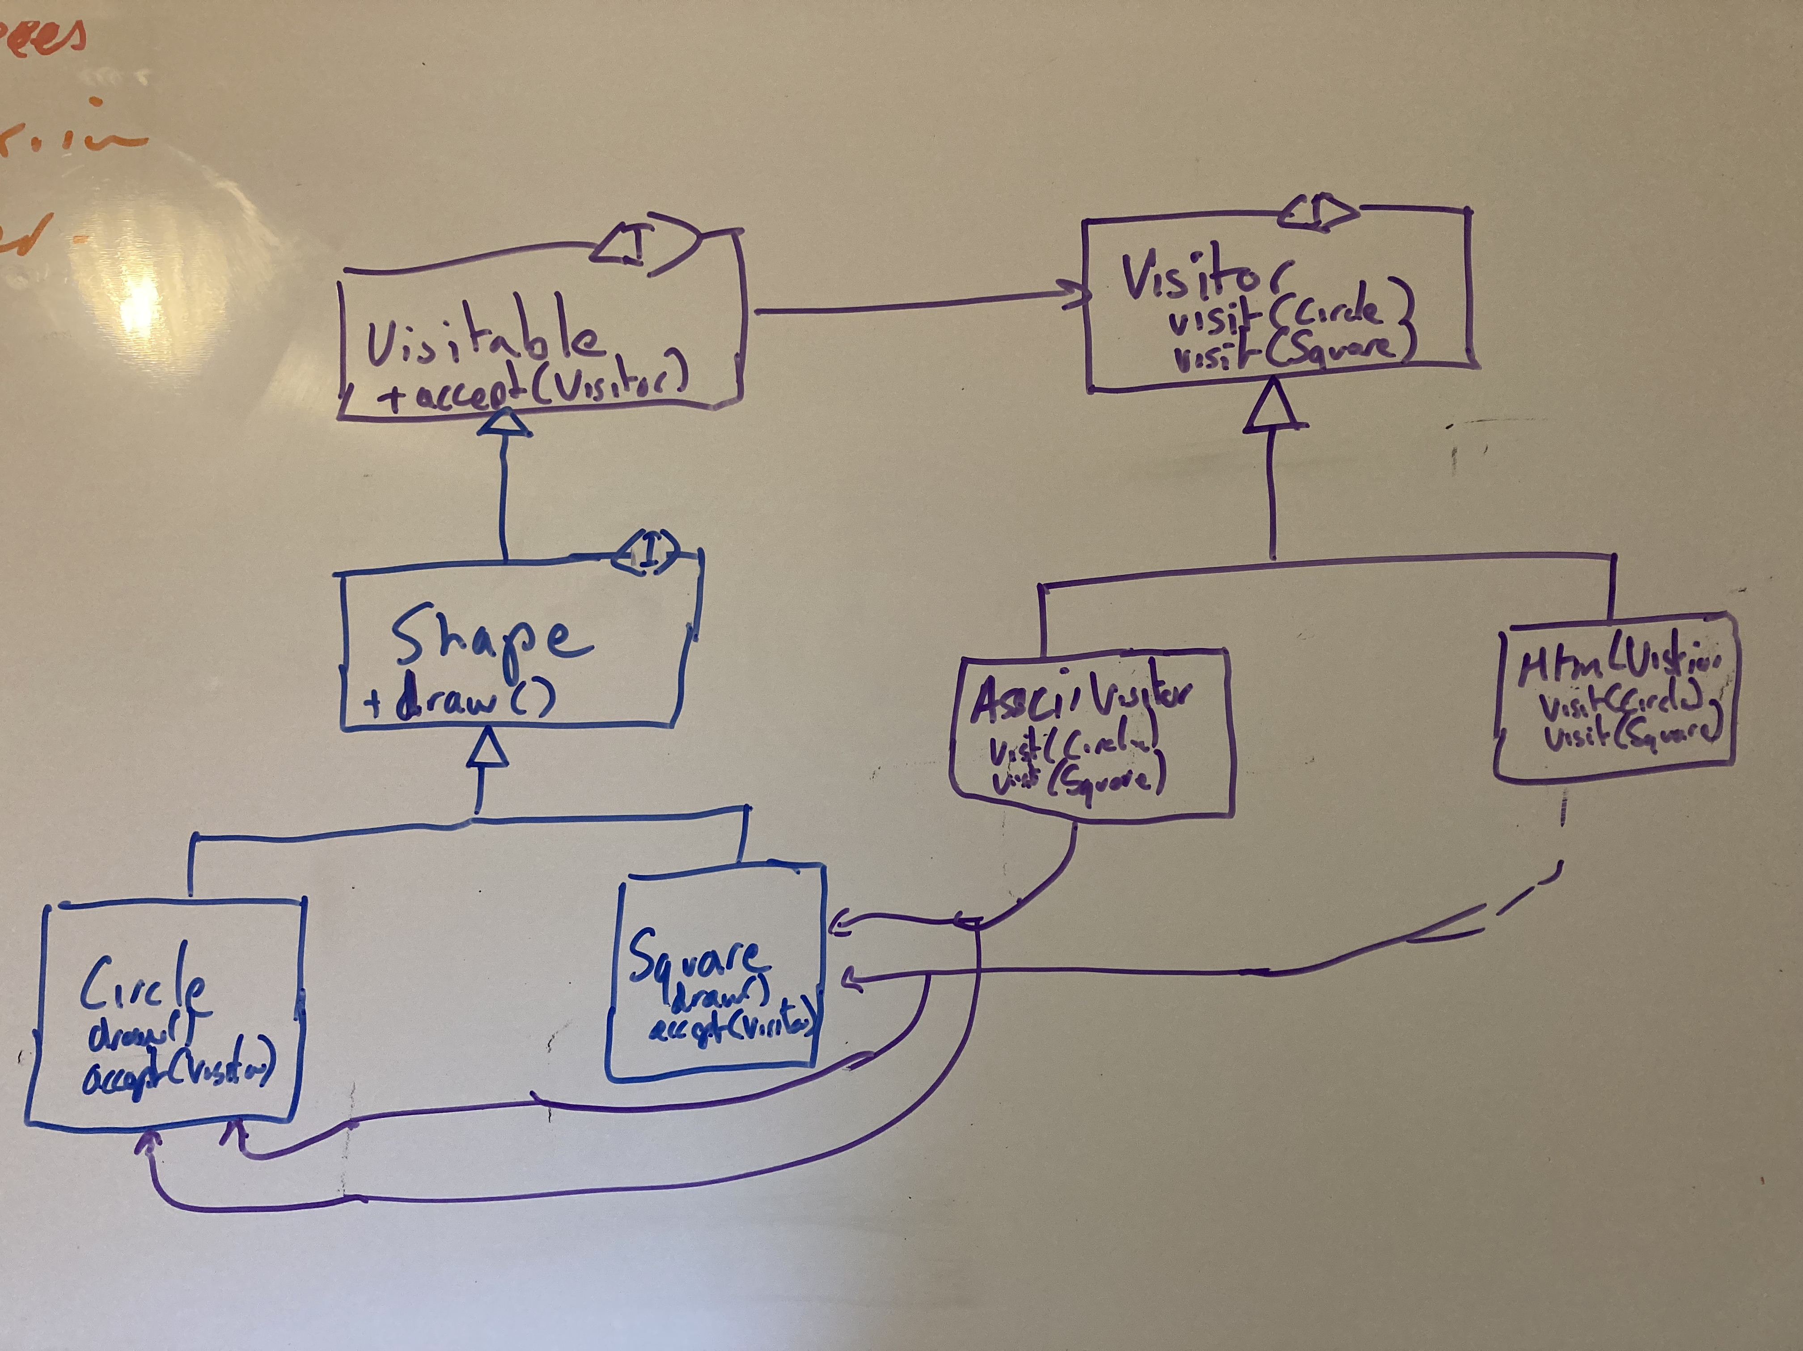
Visitor Pattern
The Shape example – we want to out an output format functionality to the Shape classes – without adding that functionality to the Shape classes.

Slide 7
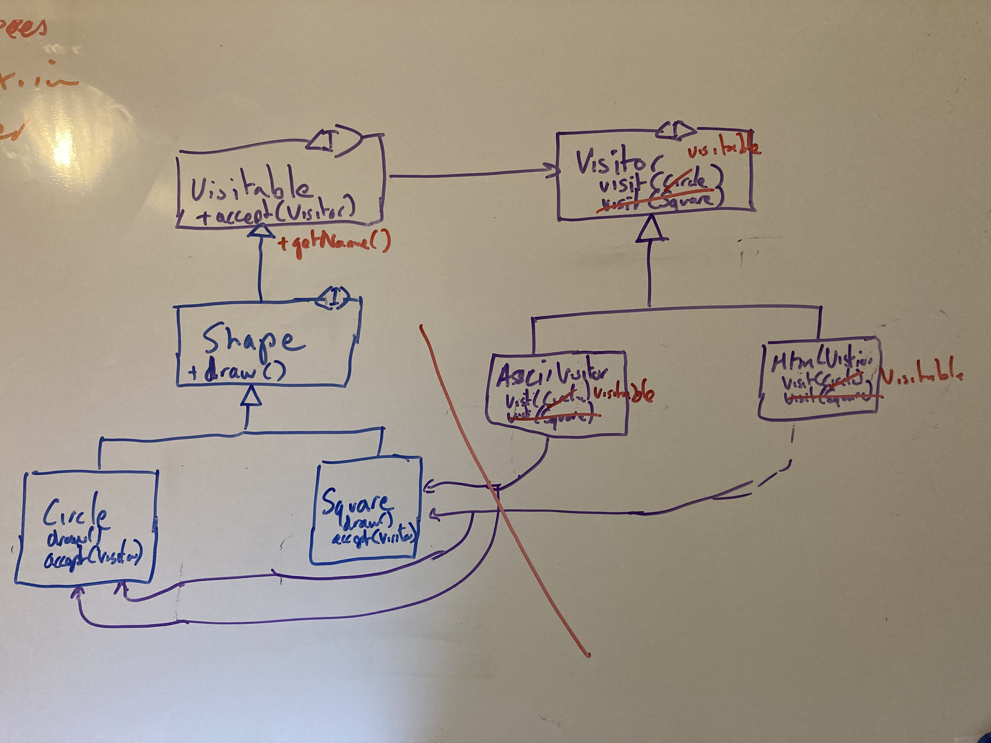
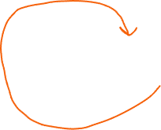

Visitor Pattern - Coupling
The Visitor needs to know about the type of Shape in the original design. Because we are only using some information from the Shape we can use a default method and break the coupling.
Cyclic Dependency
Separate this package

